Slide 1
MINI PROJECT ON REACT NATIVE-“BUCKETLIST”
SUBMITTED BY-
Pratik Sharma(191500593)
Prattyush Srivastava(191500594)
Aryan Jaiswal(191500158)
Divyam Goel(191500272)
Abhyuday Chaturvedi(191500044)
Submitted to-
Mr. Akash Kumar Choudhary

Slide 2


WHAT IS REACT NATIVE?
React Native (also known as RN) is a popular JavaScript-based mobile app framework that allows you to build natively-rendered mobile apps for iOS and Android. The framework lets you create an application for various platforms by using the same codebase

Slide 3
PREREQUISITES FOR THIS PROJECT
You should be familiar with programming concepts like functions, objects, arrays, and to a lesser extent, classes.
You should have a basic knowledge of JavaScript
You should have some familiarity with HTML and CSS
Finally, if you have worked with React before, you already know a lot about React Native, and there should be absolutely no problem in working with it
SETUP THE DEVELOPMENT ENVIRONMENT
Expo is a framework and a platform for universal React applications.
Install nodeJS on the computer.
Get the command-line tool for Expo; for that, type the required commands in the command prompt or terminal

Slide 4

Table of contents
Login Screen
We have created user authentication on the home screen with the help of firebase.
Home Screen
Search Screen
Is the color of blood, and because of this it has historically been associated with sacrifice, danger and courage.
List Screen
Is the color of gold, butter and ripe lemons. In the spectrum of visible light, yellow is found between green and orange.
Conclusion
Is the colour of the clear sky and the deep sea. It is located between violet and green on the optical spectrum.

Slide 5
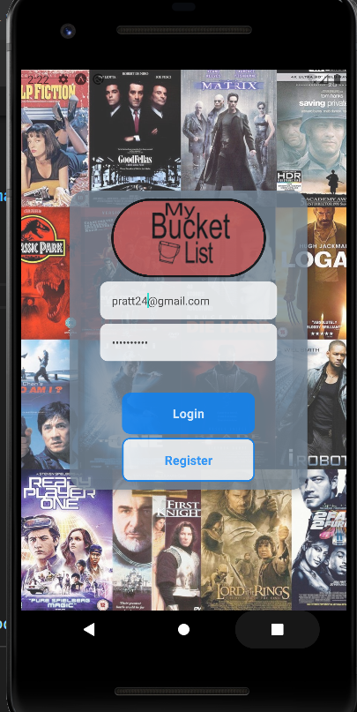
Login Screen
The Login Screen of this app provides user authentication using Firebase in the backend.
The user can Register or Login using the respective buttons.

Slide 6
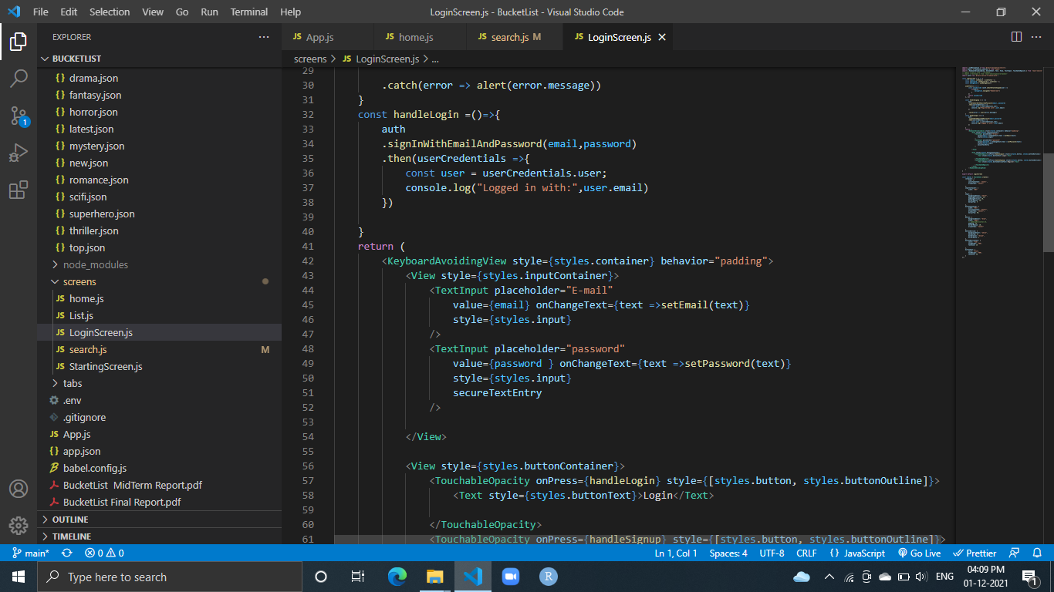
Code snippet of login screen

Slide 7
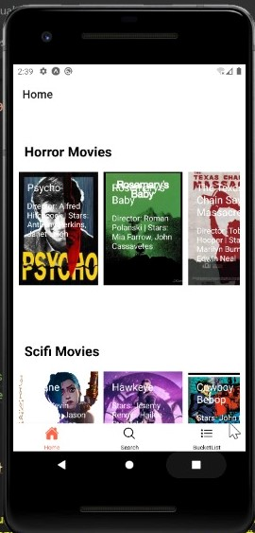
Home Screen
The home screen displays various movies distributed according to their category and genre. It also includes the latest and top ranked IMDB movies. The user can select a movie and add it to his/her bucket list.

Slide 8
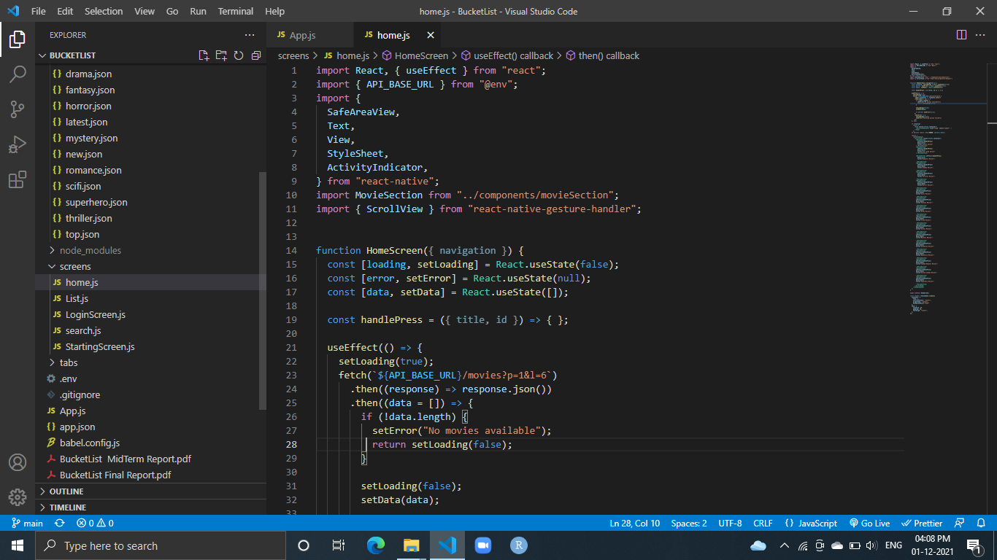
Code snippet of home screen

Slide 9
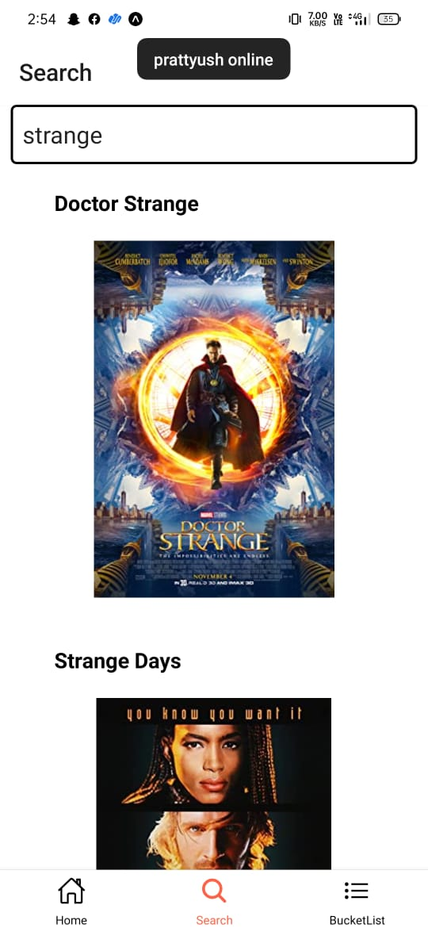
Search Screen
The search screen provides the search space where a user can find a particular movie along with its information.
The seacrh button can be accessed from the manu bar at the top.

Slide 10
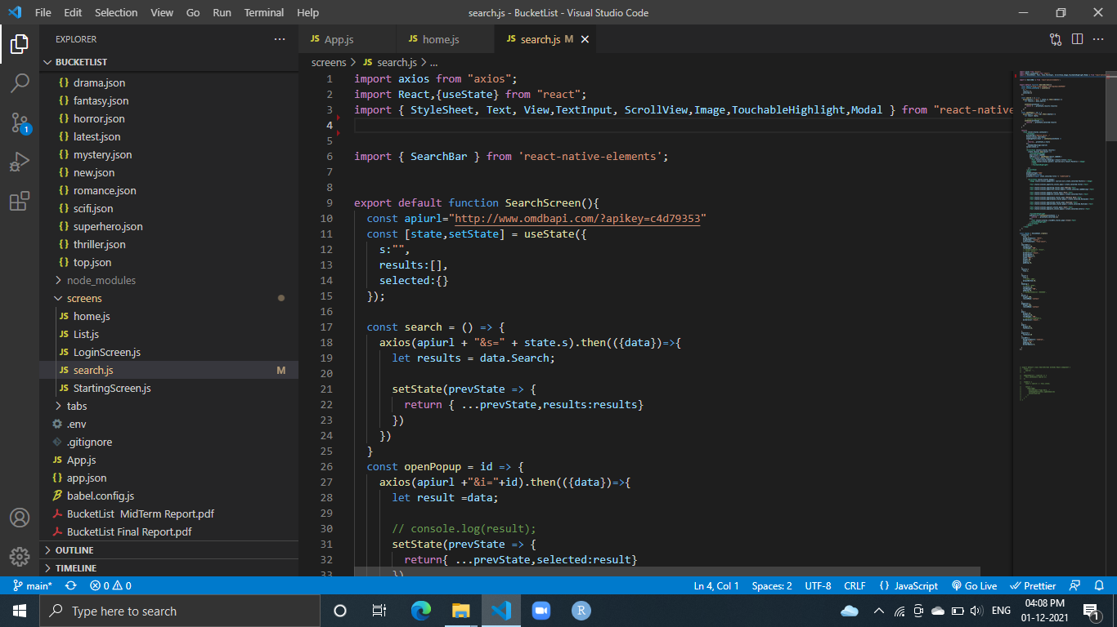
Code snippet of search screen

Slide 11
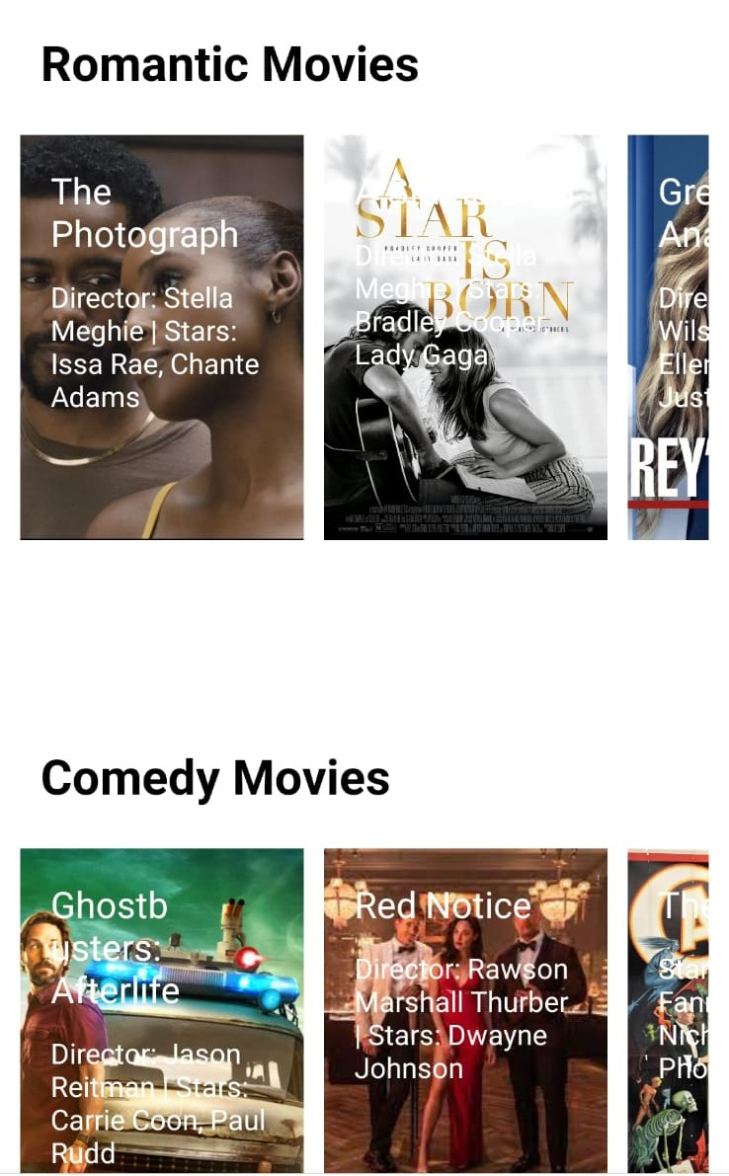
List Screen
The user’s curated watchlist appears in this screen

Slide 12
CONCLUSION
Proposed BucketList App is an react based application that will allow users to search for their favorite by title. This application takes in a user input and searches the API with the user input and gets a list of movies and web series. Search result screen will contain a list of movies and shows.

Slide 13
Project related Documents
Synopsis:
https://github.com/aryanjais/BucketList/blob/main/BucketListSynopsis.pdf
Project Report
https://github.com/aryanjais/BucketList/blob/main/BucketList%20Final%20Report.pdf
Repository Link
https://github.com/aryanjais/BucketList

